Slide 1


Cardiovascular Dataset
EDA Presentation
18 Nov 2021

Slide 2
Agenda
1
3
Tools &
Conclusion
Design
Answers
Data
2
4

Slide 3
Data
01

Slide 4
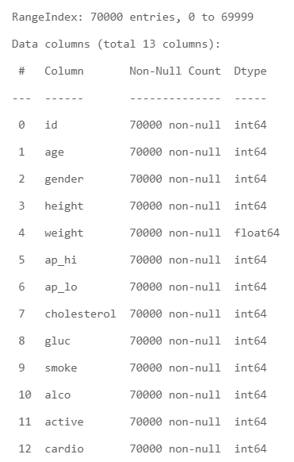
The Brief
This dataset has 70,000 observation and 13 column.
All of the dataset values were collected at the moment of medical examination.

Slide 5
BUT !
There is some outliers and wrong values

Slide 6
The Challenge
To clean the data and handle all outliers.

Slide 7
Ways for handling outliers
Drop.
Reassign.

Slide 8
Design
02

Slide 9
At This Pointlet’s see what we want to know from this dataset:
1
What is the most gender is exposed to be Cardiovascular Disease that has?
2
Is there a relationship between age and getting Cardiovascular Disease?
what is the age that has the most patient number of Cardiovascular Disease?
3
What is the most BMI that have a lot of infection by Cardiovascular Disease?
4
How many cholesterol patients have a Cardiovascular ?
5
SB pressure and DB pressure range that have a lot of cardiovascular?

Slide 10
Answers
02

Slide 11
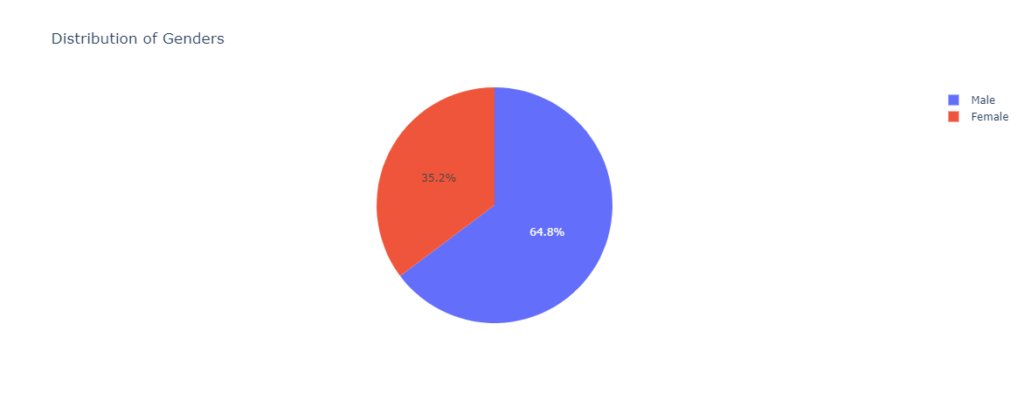
Q1:What is the most gender is exposed to be Cardiovascular Disease that has?

Slide 12
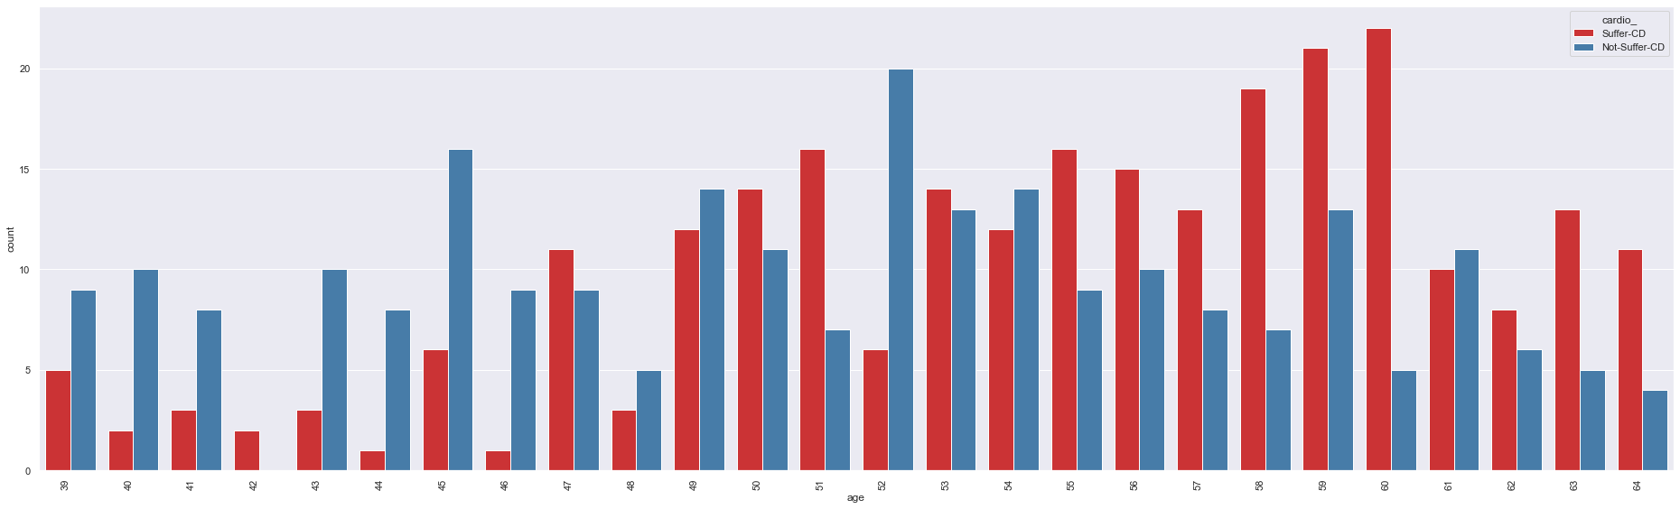
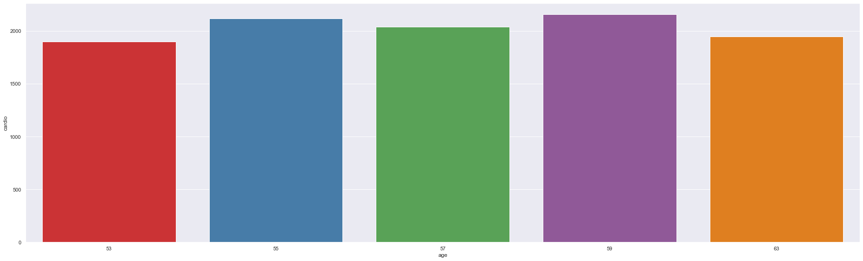
Q2:Is there a relationship between age and getting Cardiovascular Disease?
- what is the age that has the most patient number of Cardiovascular Disease?

Slide 13
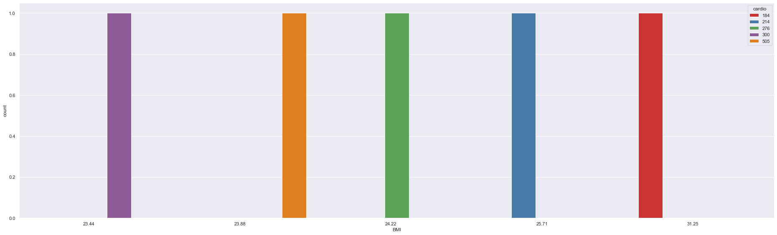
Q3: What is the most BMI that have a lot of infection by Cardiovascular Disease?

Slide 14
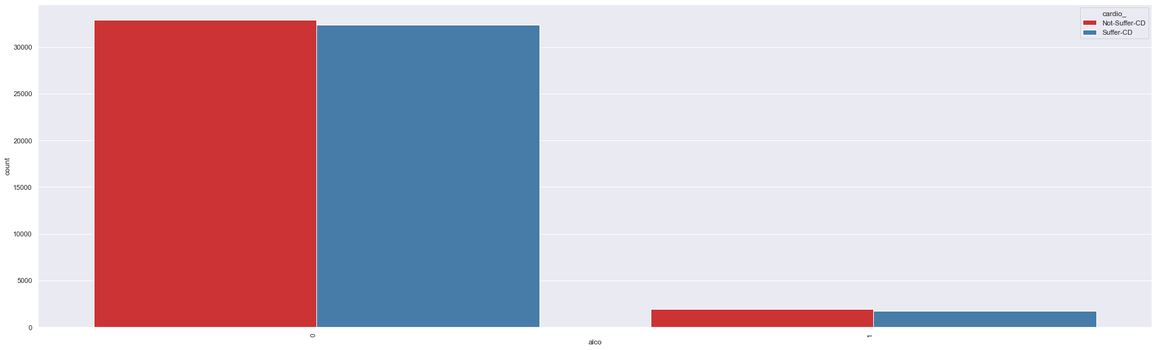
Q3: How many cholesterol patients have a Cardiovascular ?

Slide 15
Q3: How many cholesterol patients have a Cardiovascular ?

Slide 16
Tools
04

Slide 17




Tools:
Python
Pandas
Plotly
VScode

Slide 18
Conclusion
04

Slide 19
Thanks For Listening
Feedback ?

